Slide 1

Data analytics project
Shreya Sharan
​

Slide 2
Table of contents
1
2
3
4
5
Introduction
Data collection and preparation
Statistical Analysis & Insights
Exploratory Data Analysis
Conclusion and references

Slide 3

Olympic data analysis
1.1 About Data
The Olympics is one of the most prestigious sporting events, bringing together athletes from across the world to compete in various disciplines. Analysing historical Olympic data provides valuable insights into trends in participation, performance, and country-wise dominance. This report presents an in-depth analysis of Olympic data using statistical and visualization techniques to uncover patterns and key findings.

Slide 4

We will use the dataset named Olympic data, which will contain the following columns for various types of analysis. ● City: The city where the Olympics took place. ● Year: The year of the Olympics. ● Sport: The sport the event is categorized under. ● Discipline: A subcategory of the sport. ● Event: The specific event within a discipline. ● Athlete: The name of the athlete who participated. ● Gender: The gender of the athlete. ● Country_Code: The country code (abbreviation). ● Country: The full name of the country. ● Event_gender: The gender category of the event. ● Medal: The medal won (Gold, Silver, Bronze)

Slide 5
1.2 Objective of the project
To analyse historical Olympic data to uncover key trends, patterns, and insights related to athlete participation, country performance, and medal distribution. This project aims to:
✅ Identify trends in athlete participation across different Olympic games. ✅ Analyze country-wise medal performance and dominance in various sports. ✅ Examine gender distribution and its evolution over time. ✅ Assess the impact of hosting the Olympics on a country’s performance.

Slide 6
2. Data Collection & Preparation
2.1 Data Sources
The dataset used for this analysis consists of historical Olympic records, including details about athletes, events, medal winners, and country-wise participation. The data was sourced from publicly available repositories.
2.2 Tools used
SQL for data cleaning and analysing the data.
Tableau for visualisation and exploratory data analysis.

Slide 7
2.3 Data Cleaning & Preprocessing Before performing any analysis, the data was cleaned by:
Handling missing values
delete from olympic_data
where city is null
or year is null
or sport is null
or discipline is null
or event is null
or athlete is null
or gender is null
or country_code is null
or country is null
or event_gender is null
or medal is null;
Result: The above query will delete all the missing or null values from the dataset

Slide 8
Removing duplicate records with cte as ( select *, row_number() over(partition by athlete,event,medal) as rn from olympic_data) delete from olympic_data where (athlete, event, medal) in ( select athlete, event, medal from cte where rn>1); Result: This will delete all duplicate rows from the dataset, and the dataset will be ready to analyse. Converting data types for numerical analysis. Query: alter table Olympic_data modify year int; Result: It will change the datatype of the column year in the dataset.

Slide 9

Statistical Analysis & Insights

Slide 10
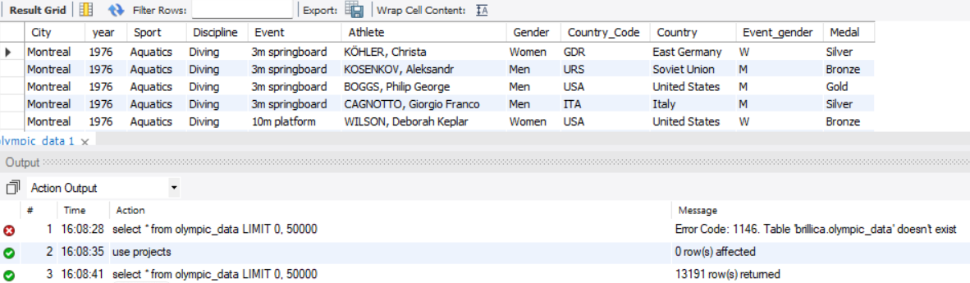
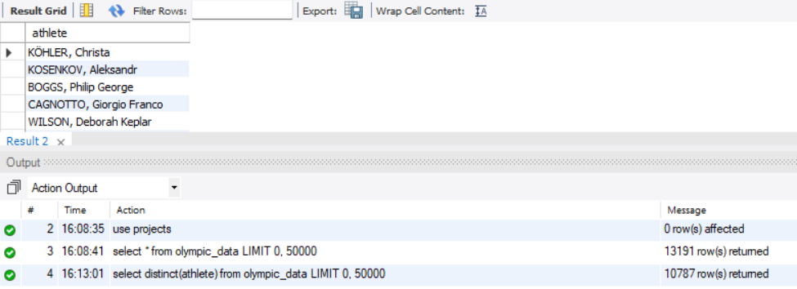
Basic overview
Total rows
select * from olympic_data;
Unique athletes
select distinct(athlete) from olympic_data;

Slide 11
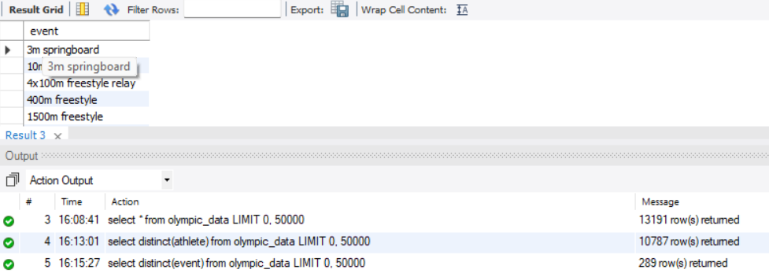
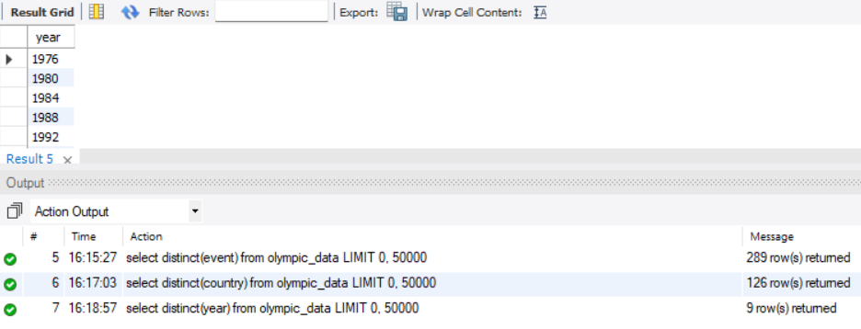
Unique events
select distinct(event) from olympic_data;
Unique years
select distinct(year) from olympic_data;

Slide 12
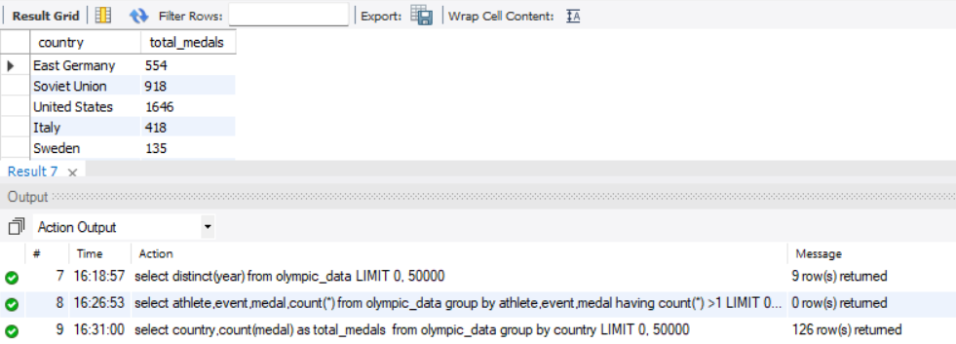
Distribution of medal by country
select country, count(medal) as total_medals from olympic_data group by country;

Slide 13
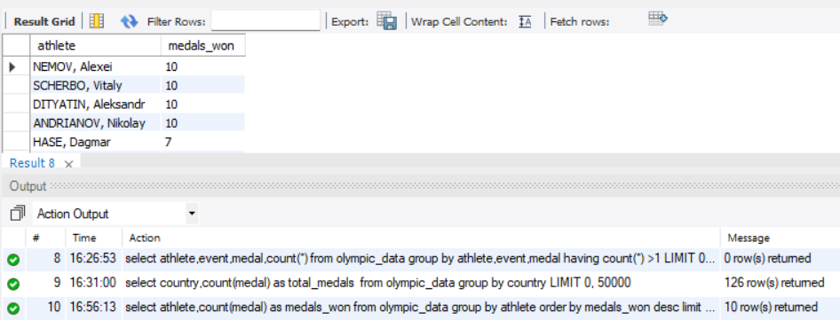
Top 10 athletes with most medals
select athlete, count(medal) as medals_won
from olympic_data
group by athlete
order by medals_won desc
limit 10;

Slide 14
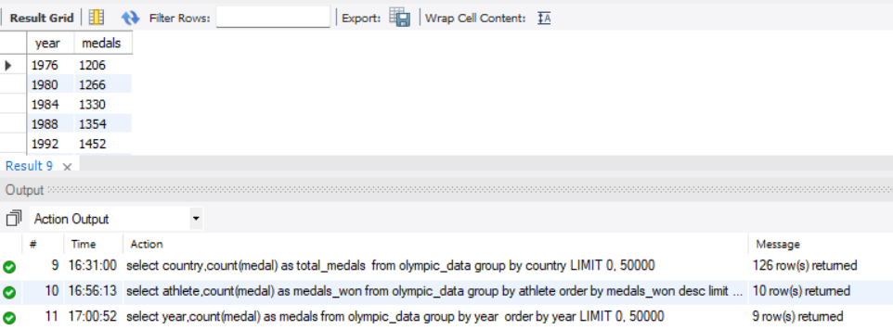
Medal trends over time
select year, count(medal) as medals
from olympic_data
group by year
order by year;

Slide 15
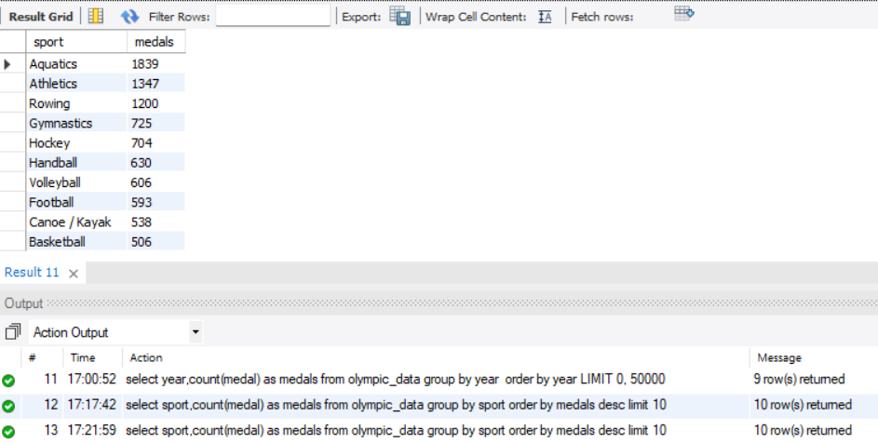
Top 10 successful sport.
select sport, count(medal) as medals
from olympic_data
group by sport
order by medals desc
limit 10;

Slide 16
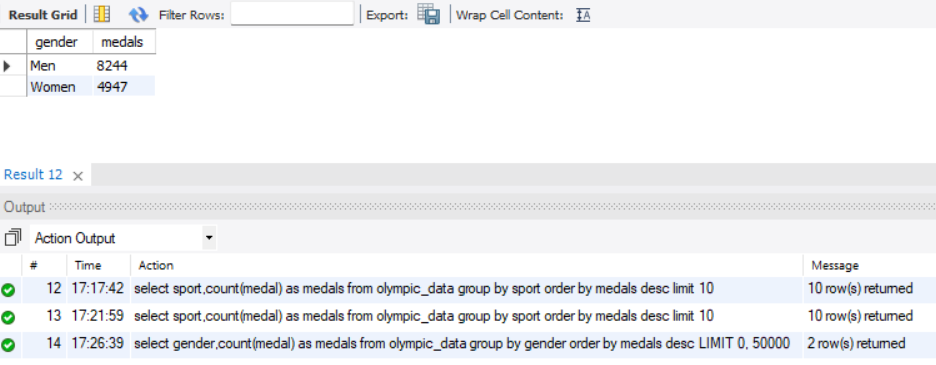
Gender distribution of medals
select gender, count(medal) as medals
from olympic_data
group by gender
order by medals desc;

Slide 17
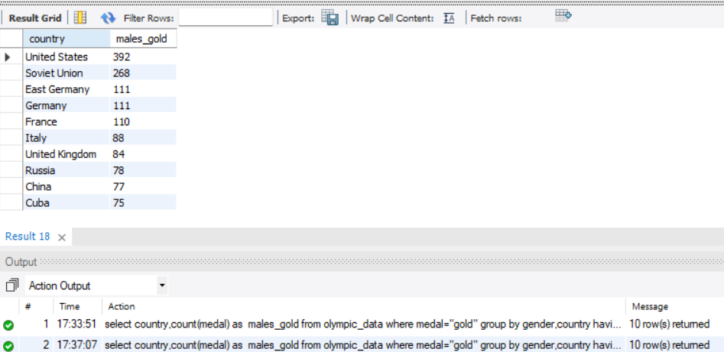
Top 10 countries whose males athletes won gold medal
select country, count(medal) as males_gold
from olympic_data where medal="gold"
group by gender, country
having gender="men"
order by males_gold desc
limit 10;

Slide 18
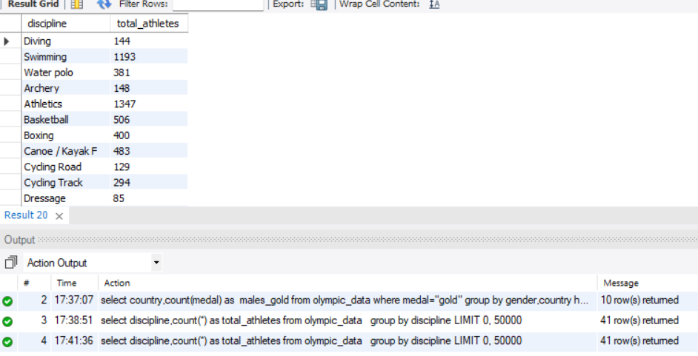
Total athlete in a particular sport discipline
select discipline,count(*) as total_athletes
from olympic_data
group by discipline;

Slide 19
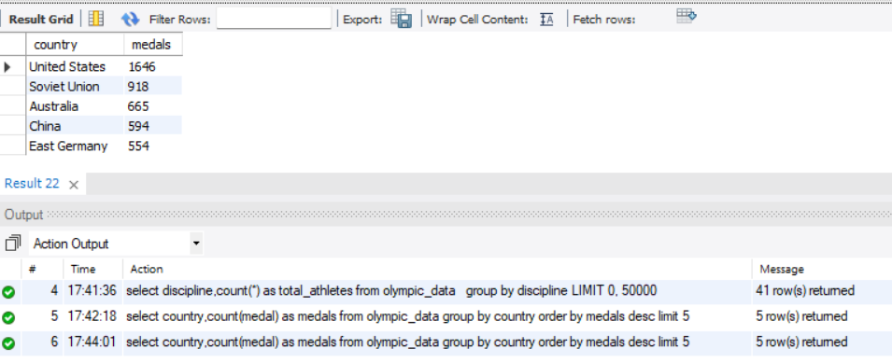
Top 5 countries who won maximum number of medals
select country, count(medal) as medals
from olympic_data
group by country
order by medals desc
limit 5;

Slide 20
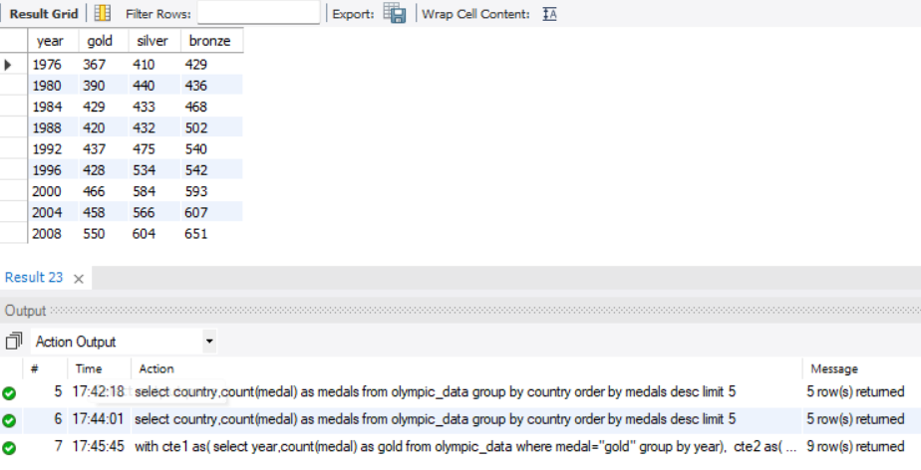
Different types of medal won over the years
with cte1 as(
select year, count(medal) as gold
from olympic_data
where medal="gold"
group by year),
cte2 as(
select year, count(medal) as silver
from olympic_data
where medal="silver"
group by year),
cte3 as(
select year, count(medal) as bronze
from olympic_data
where medal="bronze"
group by year)
select cte1.year,cte1.gold,cte2.silver,cte3.bronze
from cte1 inner join cte2 on
cte1.year = cte2.year
inner join cte3 on
cte2.year=cte3.year;

Slide 21
Medal distribution according to gender and country.
with cte1 as(select country,count(medal) as men_gold from olympic_data where medal="gold" and gender="men" group by country),
cte2 as (select country,count(medal) as women_gold from olympic_data where medal="gold" and gender="women" group by country),
cte3 as (select country,count(medal) as men_silver from olympic_data where medal="silver" and gender="men" group by country),
cte4 as(select country,count(medal) as women_silver from olympic_data where medal="silver" and gender="women" group by country),
cte5 as(select country,count(medal) as men_bronze from olympic_data where medal="bronze" and gender="men" group by country),
cte6 as (select country,count(medal) as women_bronze from olympic_data where medal="bronze" and gender="women" group by country)
select cte1.country,cte1.men_gold,cte2.women_gold,cte3.men_silver,cte4.women_silver,cte5.men_bronze,cte6.women_bronze
from cte1 inner join cte2 on
cte1.country = cte2.country
inner join cte3 on
cte2.country=cte3.country
inner join cte4 on
cte3.country=cte4.country
inner join cte5 on
cte4.country=cte5.country
inner join cte6 on
cte5.country=cte6.country;

Slide 22
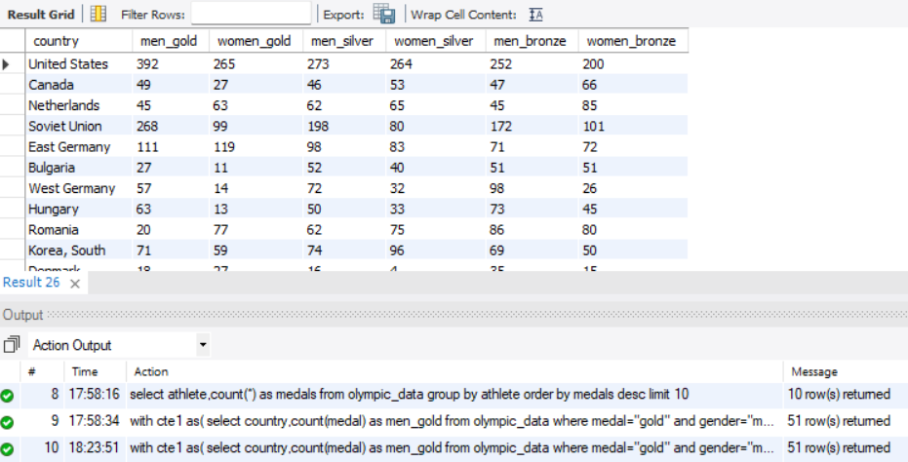

Slide 23

Exploratory Data Analysis

Slide 24
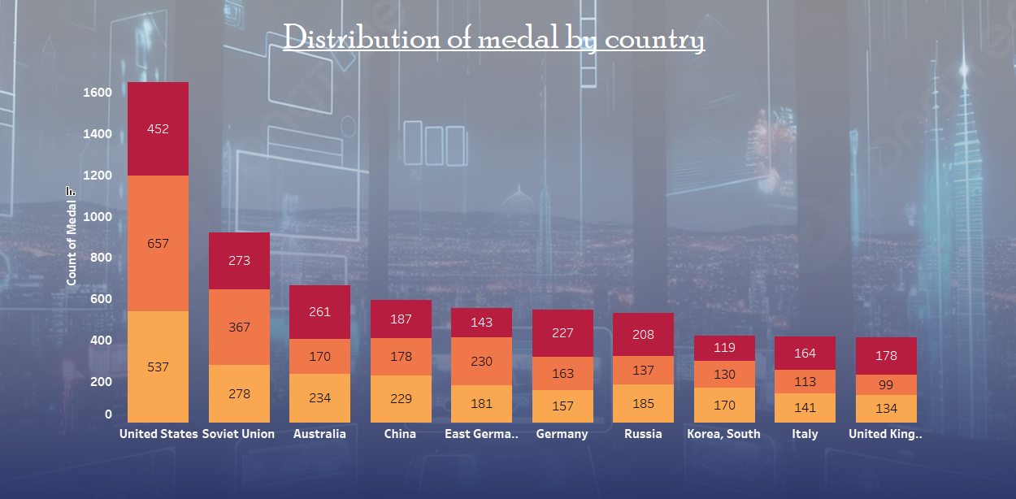
Distributing different types of medals by country
USA leads with the highest medals.
Soviet Union follows strongly.
Australia, China, and Germany
perform well.
Russia, South Korea, Italy, UK have similar medal counts

Slide 25
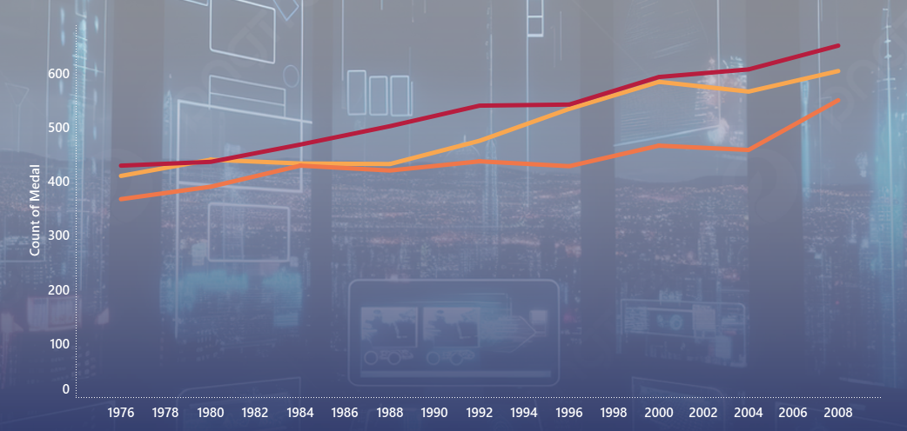
Medal trends over time
Bronze medals lead in count consistently.
Silver medals follow closely, showing steady growth.
Gold medals are the lowest but show a strong upward trend.
All medals increasing, with gold catching up after 2004.

Slide 26
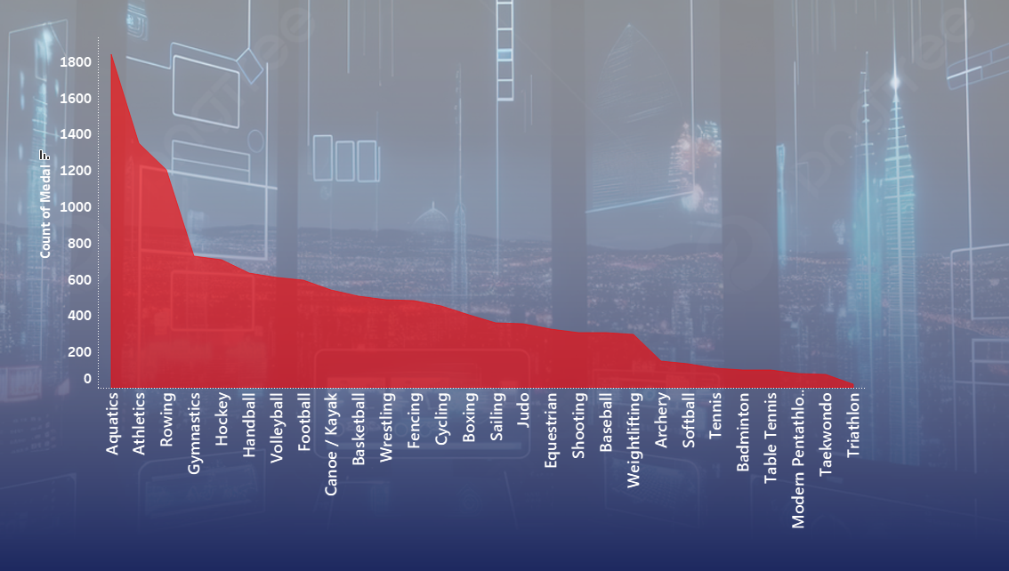
Distribution of medal by sport
Aquatics & Athletics dominate in medal count.
Rowing, Gymnastics, and Hockey follow as strong contributors.
Team sports like Volleyball, Football, and Basketball have notable counts.

Slide 27
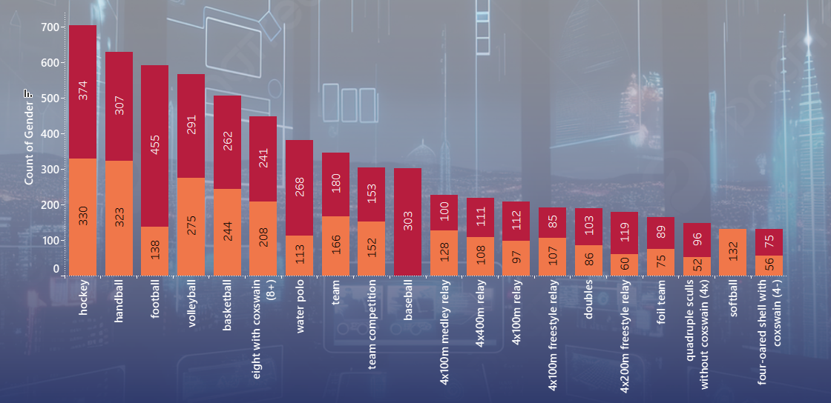
Analysing gender distribution in different events
Men dominate in Handball, Volleyball, and Baseball, having higher medal counts.
Women have strong representation in team events, especially in Volleyball and Rowing.
Rowing and Relay events show a balanced gender distribution in medals.

Slide 28
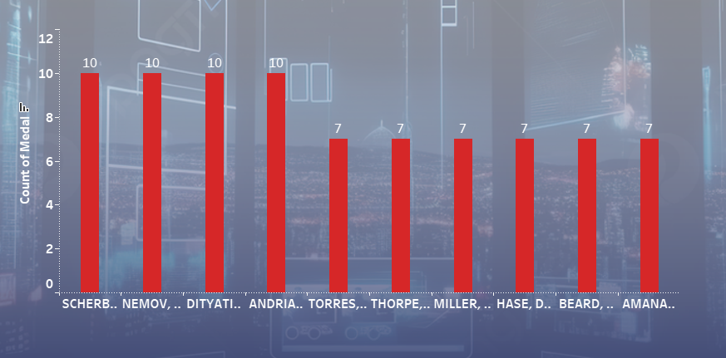
Top performing athletes performing all over the world
The top 4 athletes (Scherbo, Nemov, Dityatin, Andrianov) lead with 10 medals each.
The next 6 athletes follow with 7 medals. Gymnastics and swimming dominate.

Slide 29
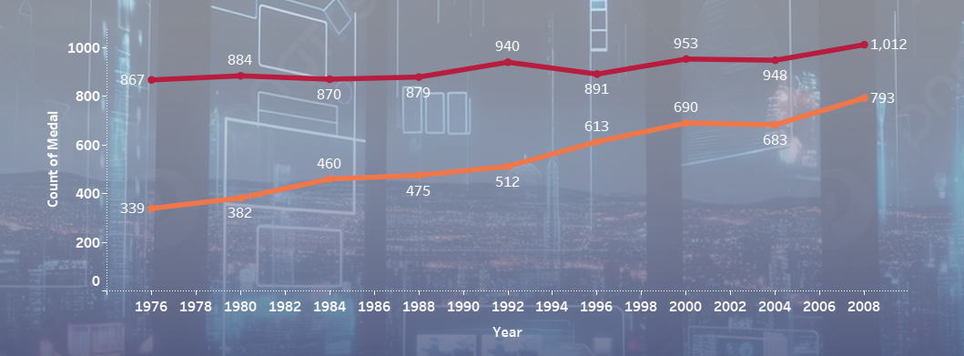
Comparison of male and female winners over time.
Males consistently won more medals, peaking at 1,012 in 2008.
Females showed strong growth from 339 (1976) to 793 (2008), narrowing the gap.

Slide 30

Conclusion and recommendations

Slide 31



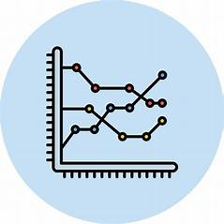

Conclusion
Top Countries
USA, China, and Russia dominate due to strong sports infrastructure.
Medal Growth
Athlete participation and events have increased significantly
Gender Representation
Female participation has risen, promoting equality.
Host Nation Advantage
Hosting boosts medal chances due to better preparation.
Popular Sports
Athletics and swimming remain highly competitive.

Slide 32
Recommendations:
Support Underperforming Nations - Provide funding and better training facilities.
Promote Gender Equality - Ensure equal opportunities for female athletes.
Invest in Infrastructure - Develop training programs to enhance performance.
Identify Talent Early - Implement structured training for young athletes.
Use Data Analytics - Leverage technology for performance improvement.
Implementing these strategies can improve national performances and uphold Olympic excellence.

